Slide 1
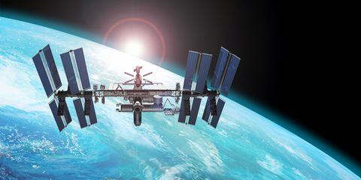

RFID Localization in International Space station
Team Xlate:
Varad Joshi
Mayuresh Deodhar
Guide and mentor Prof. Chaiyaporn Mutsalklisana

Slide 2
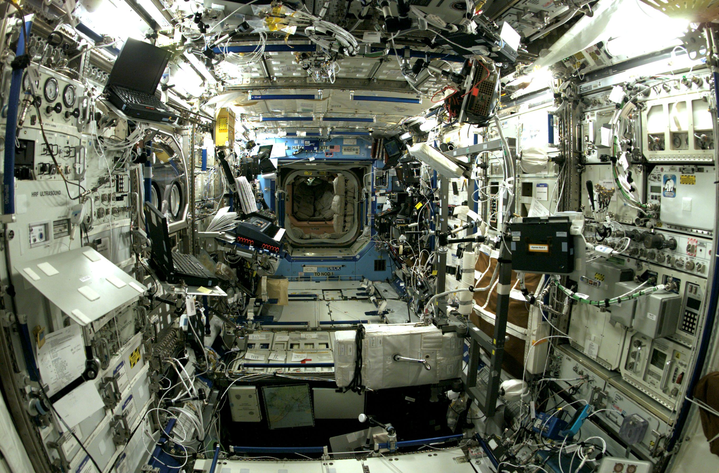
Problems Faced by Astronauts In ISS
International Space station is very big in size. Like a football ground.
There are around 8000 components onboard the ISS.
Astronauts face problems while locating the components.
Astronauts waste valuable time in searching for the components.

Slide 3
How is ISS Divided
International Space Station
Modules
Labs
Systems
Smart Drawers
Sections
Drawer Components
Lab Components

Slide 4
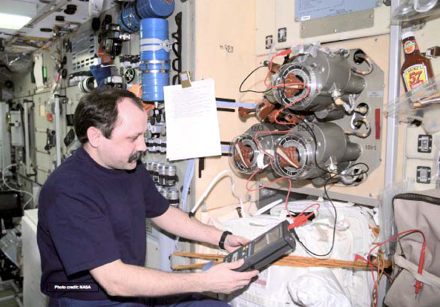
Technology Used in International Space Station
Astronauts make use of RFID scanners to locate the components.

Slide 5

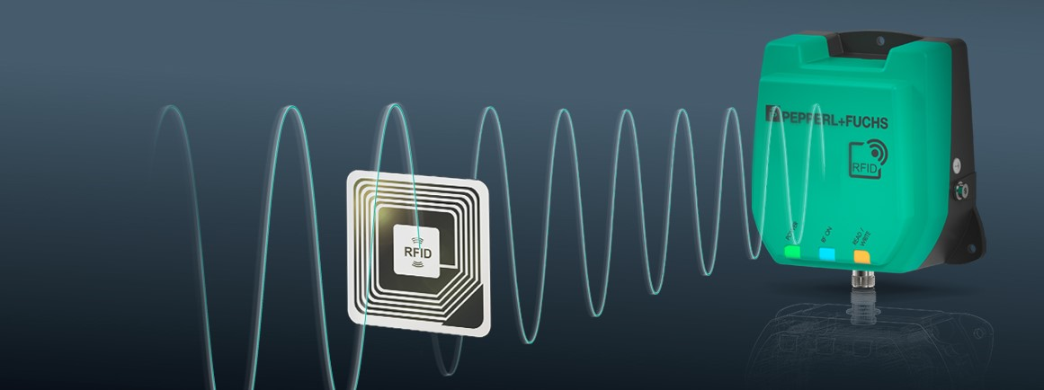
What is RFID
Radio Frequency Identification
Small RFID tags are attached to objects.
RFID readers use electromagnetic waves to track the tags.
Tags have electronic information stored in them.
Upon receiving the electromagnetic waves tags send the signals back to the reader.
Location of the object is received.

Slide 6
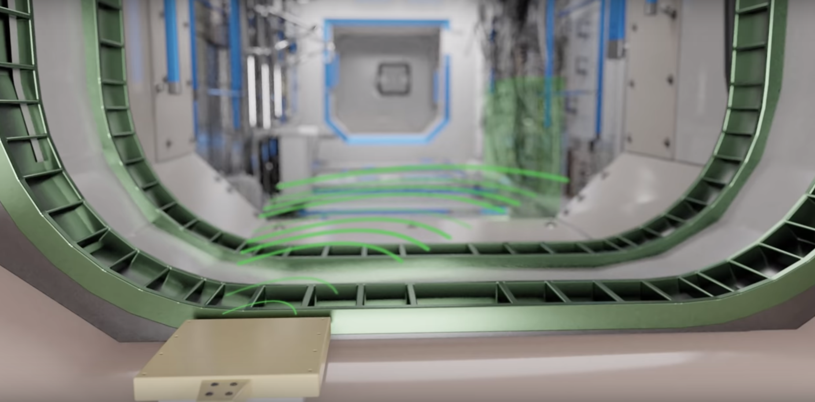
Current System
Fixed RFID scanners are placed all around the space station.
Astronaut will have device on which he will enter the component he wants.
Device will broadcast the search query to the fixed scanners.
Scanners will locate the component using electromagnetic waves.
Scanners will send the location to the astronaut via the device.

Slide 7
Problems Statement
In International Space Station there are many components made up of metals or liquids. These components might block the tag from being read. It is also a possibility that a tag may get blocked because of other components. Therefore fixed scanners won’t be able to detect the components.

Slide 8
What Does our System Include
Our system contains two things-
Astro Bee
Smart Drawers

Slide 9
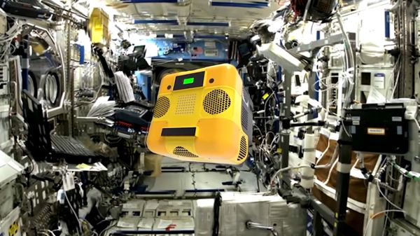
What is Astro Bee ?
Astro bee is a flying robot being developed by Nasa to help Astronauts perform some experiments.
Astro bee has propulsion system and two fans on side of it and flaps to control its flight.
Astro bee will be fitted with RFID Scanner and Image processing system which helps to detect the component accurately.

Slide 10
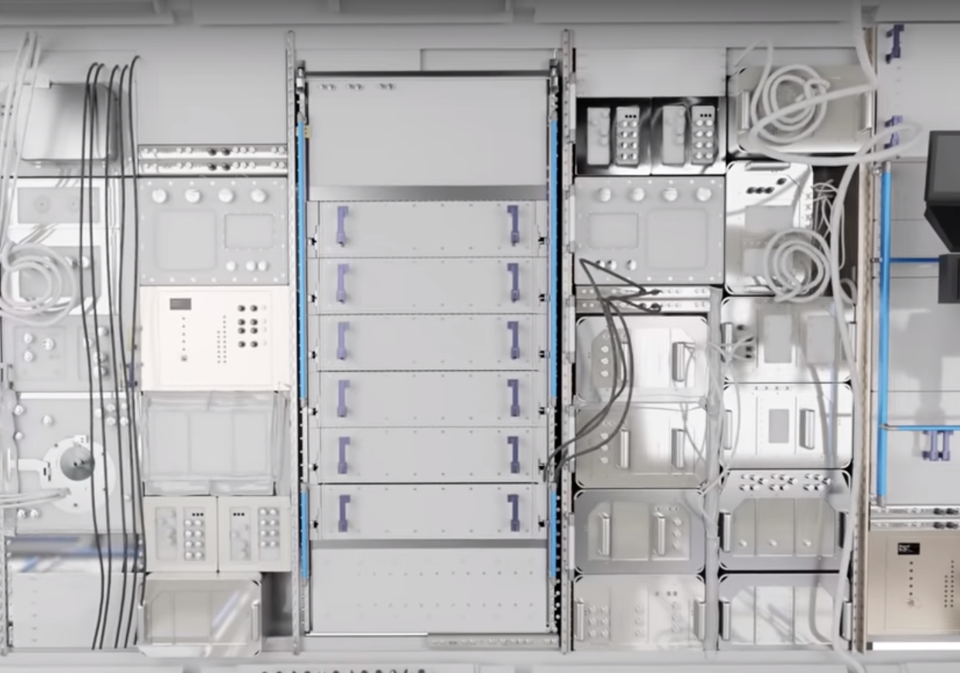
What are Smart Drawers
Drawers are fitted with their own RFID scanners inside them.
These scanners detect the components inside them which are already attached with RFID chips.

Slide 11
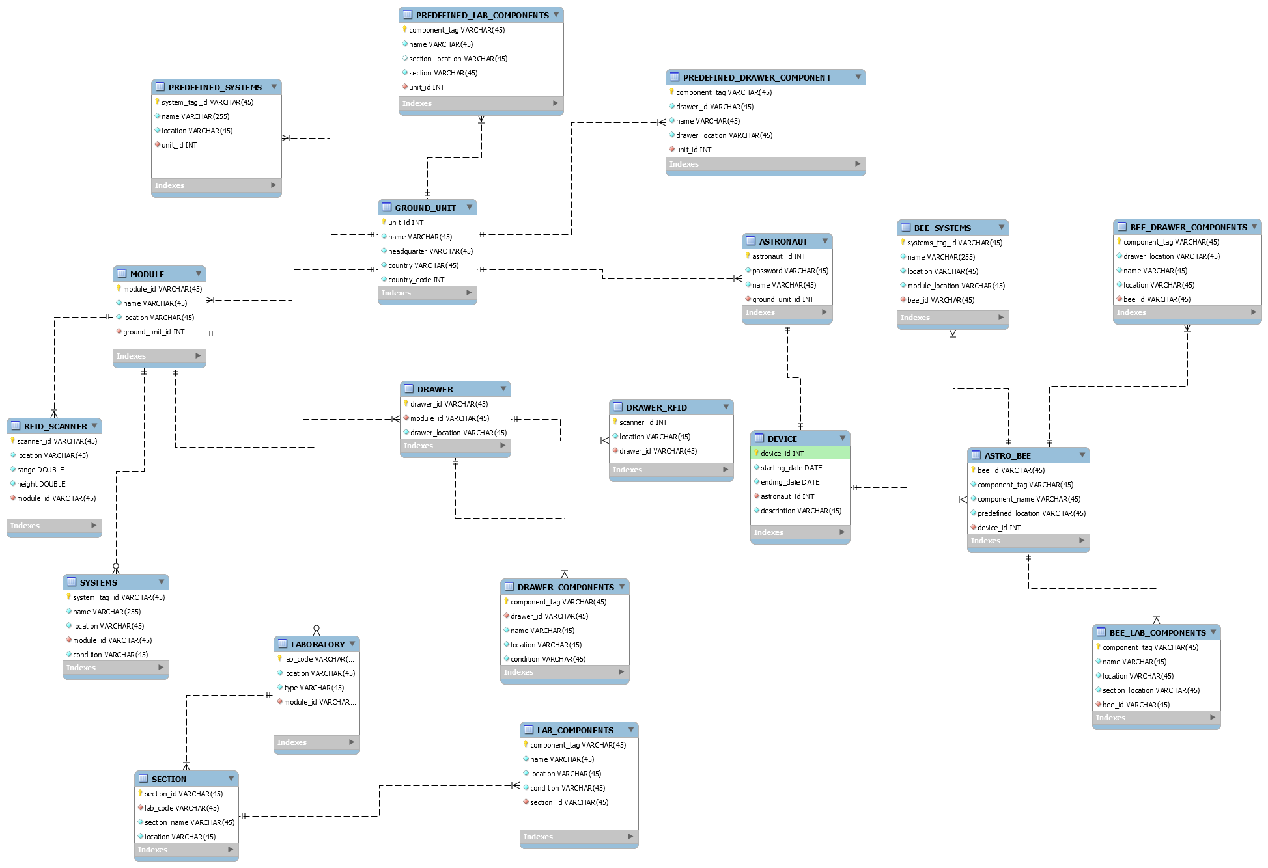
Entity Relation Diagram

Slide 12
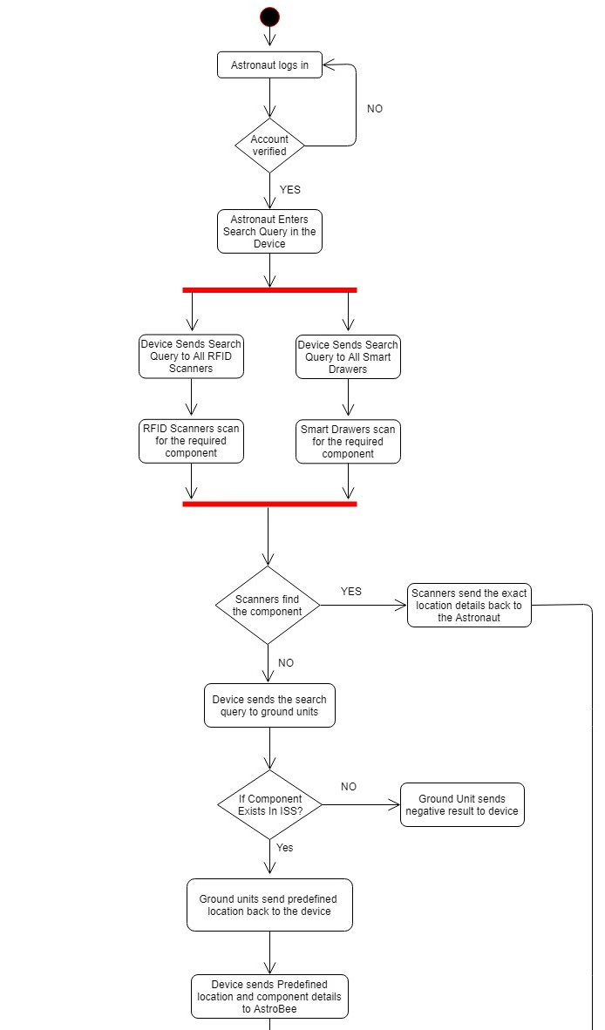
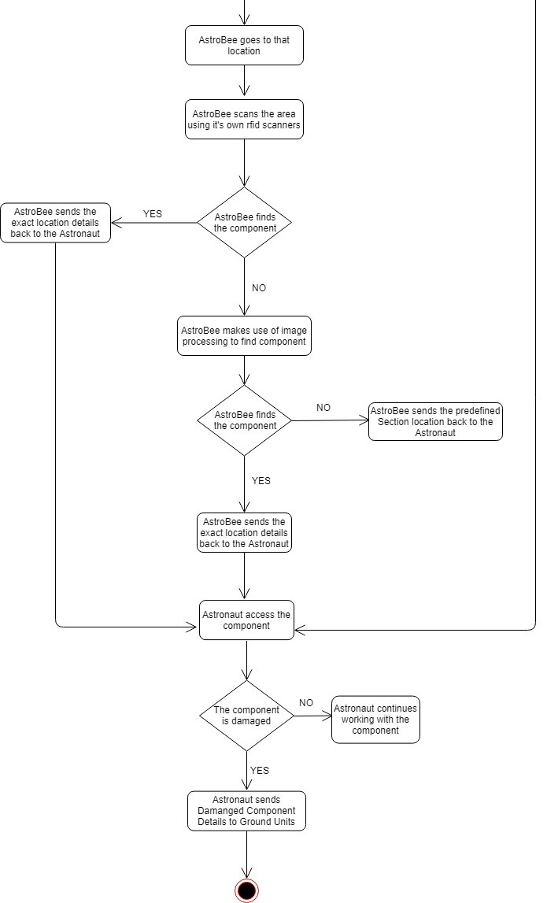
Activity Diagram

Slide 13
Working
When Astronaut is not able to locate the components with the help of Fixed scanners.
Astronaut sends the component name to ground unit.
Ground unit will check if the component exists or not on the ISS.
If the component exists on the ISS ground unit will send a predefined section location to the Astronaut.
Predefined section location is where the probability of finding the component is high.
Astronaut will send these location details to the Astro Bee.

Slide 14
Working
Astro bee will be deployed on that location.
It will scan the RFID tags of the components present in that section.
IF the tag on that component is blocked but the component is partially or fully visible then image processing system on the Astro bee can be able to detect the component.
After detection of the component Astro bee will send the components location.

Slide 15
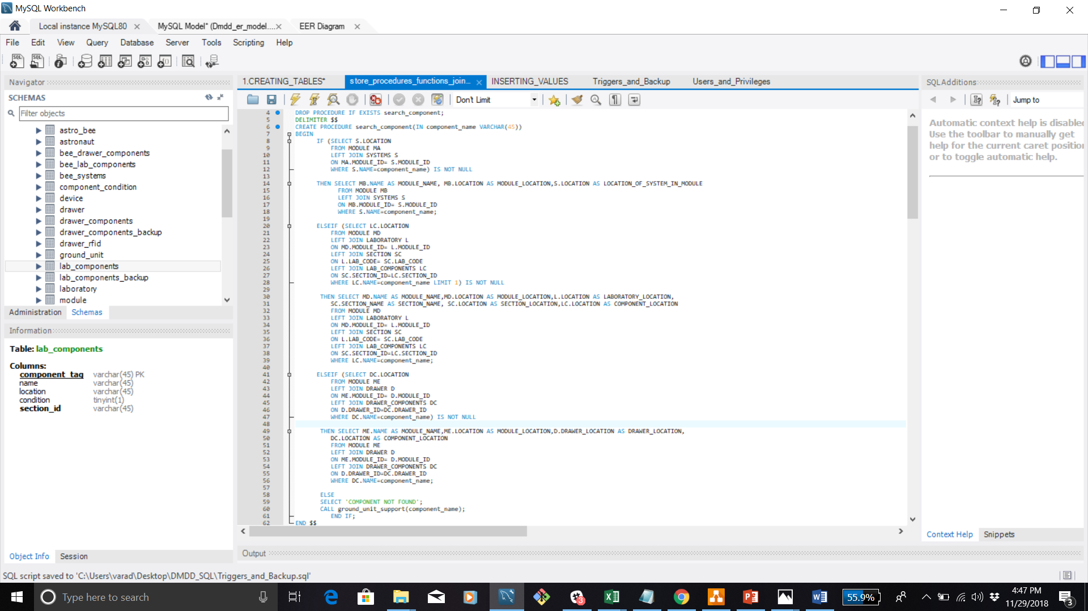
Searching components With fixed scanners

Slide 16
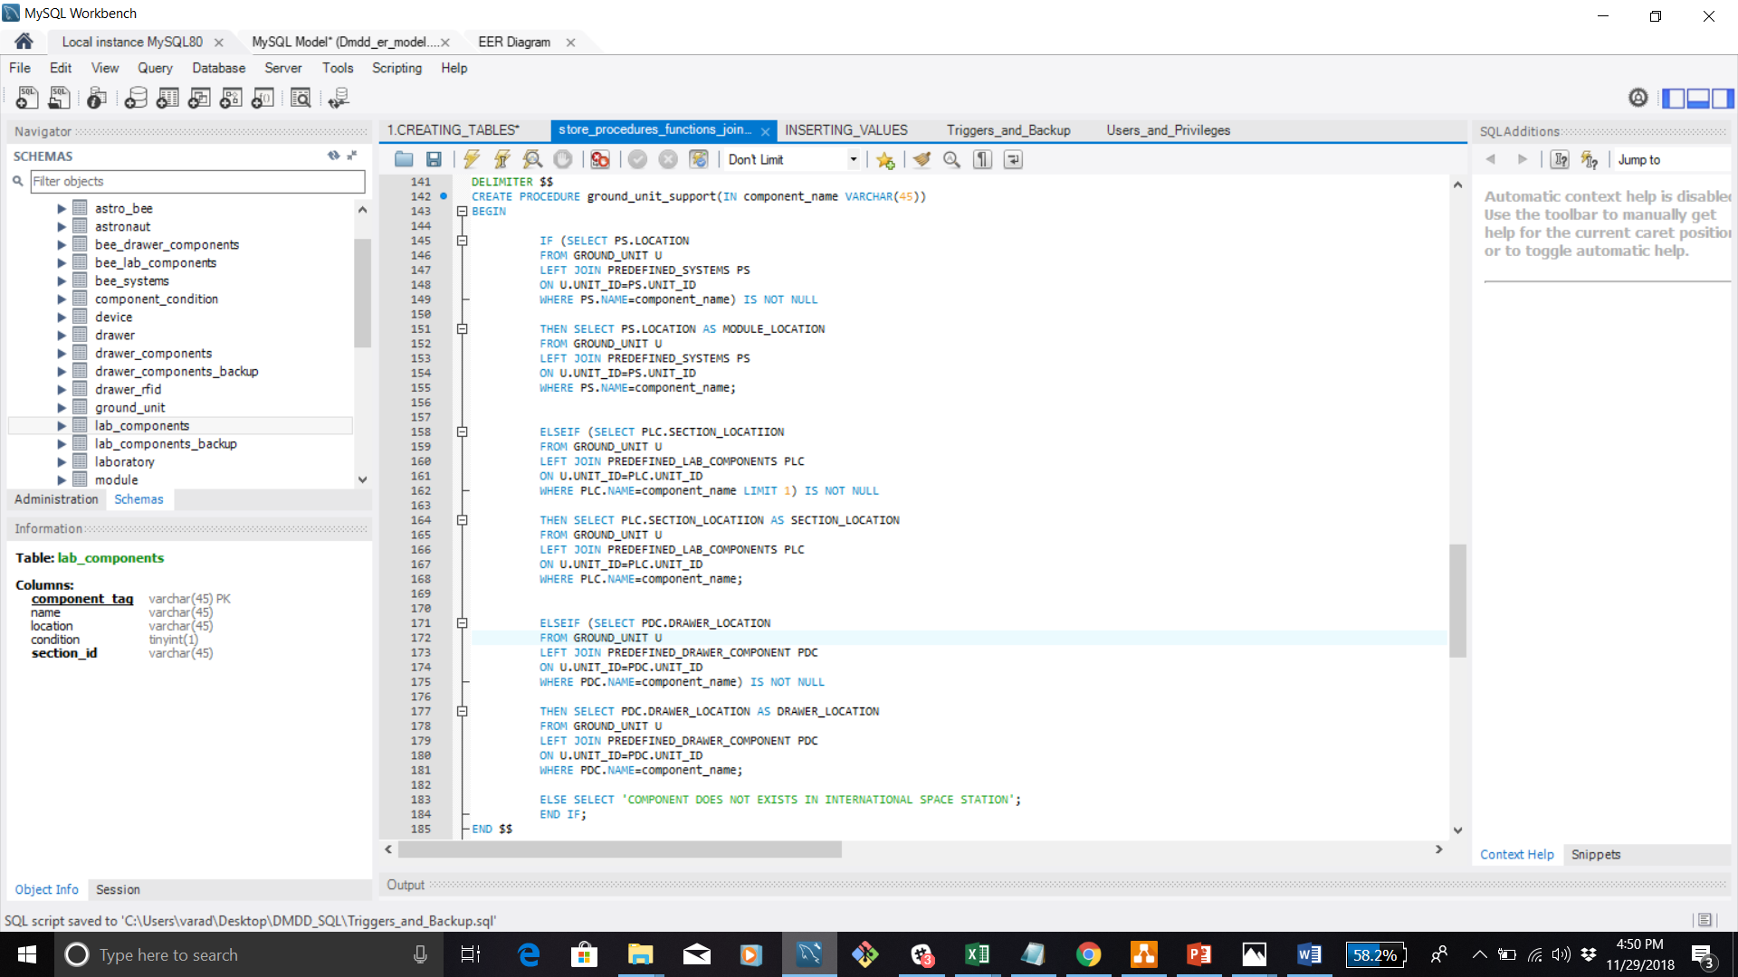
Ground Unit Support For Predefined Section Location

Slide 17
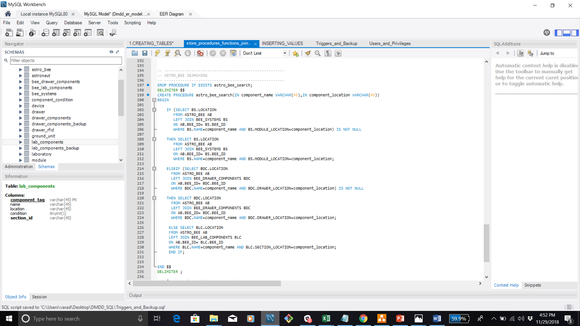
Astro bee searches For Component

Slide 18
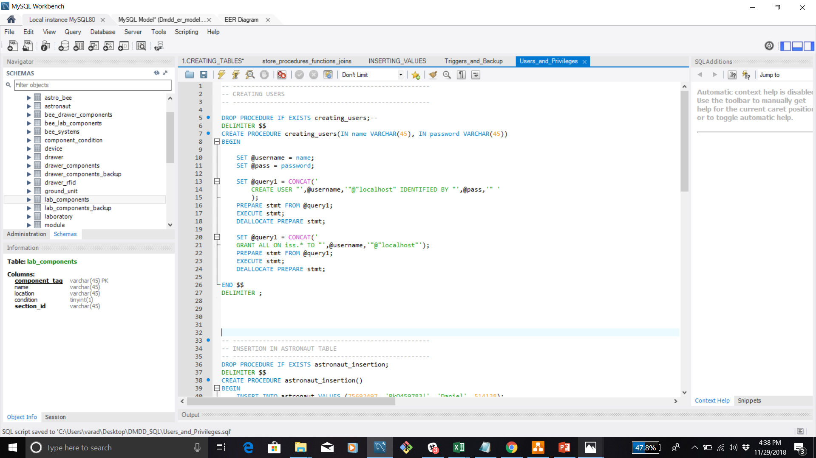
Privileges

Slide 19
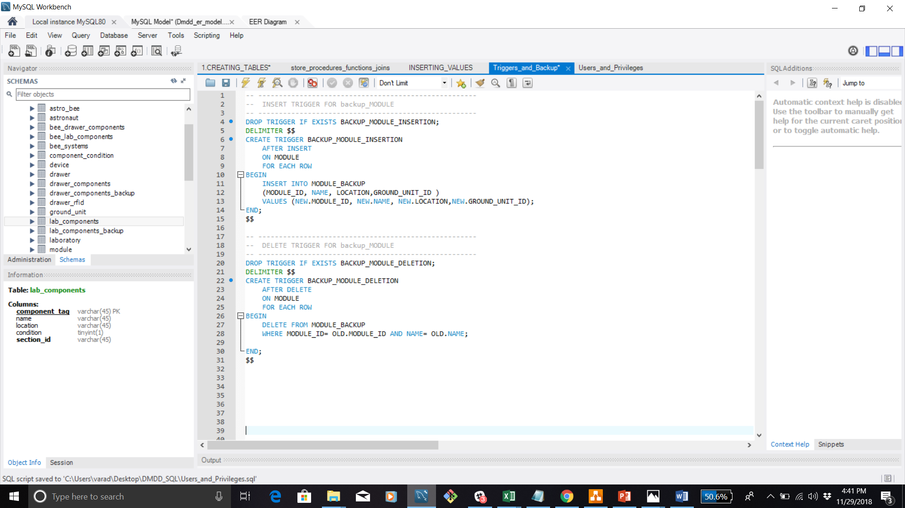
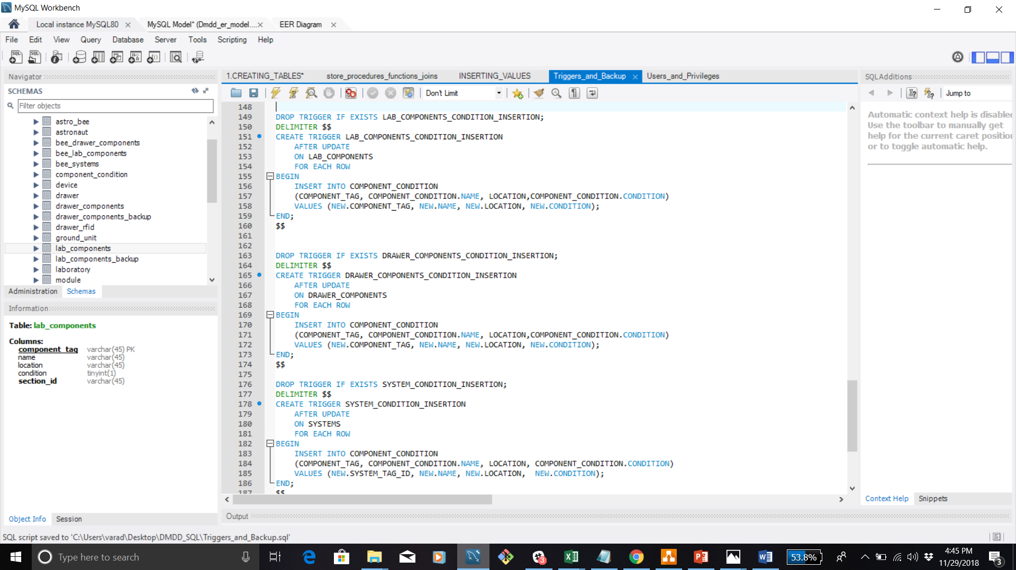
Triggers

Slide 20
THANKS

